Slide 1

Brain Tumor Detection
NAME : SACHIN SATI
COURSE : BTech
BRANCH : COMPUTER SCIENCE
SECTION : C
SEMESTER : VI
ROLLNO:52
UNI ROLLNO:1018568
SUBMITTED TO : Mr. INDERJEET KUMAR
MENTOR : Mr. AMIT GUPTA

Slide 2
TABLE OF CONTENTS
Introduction
DataSet
Work Structural Chart
Models used and overview of the models
Results

Slide 3
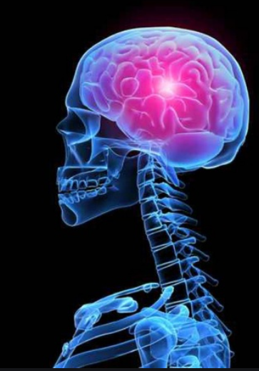
INTRODUCTION
Brain Tumor Detection is a technique which involves study of the brain tumors, which can be detected easily from brain MRI image .
MRI Images are widely used for high quality imaging mostly in brain scanning images because brain tumors are easily tracked by these images.

Slide 4
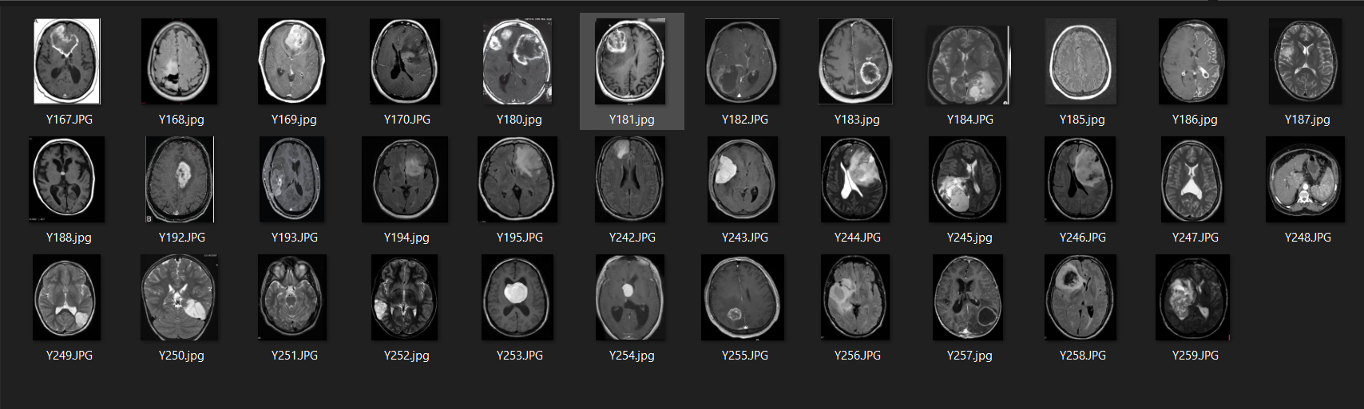
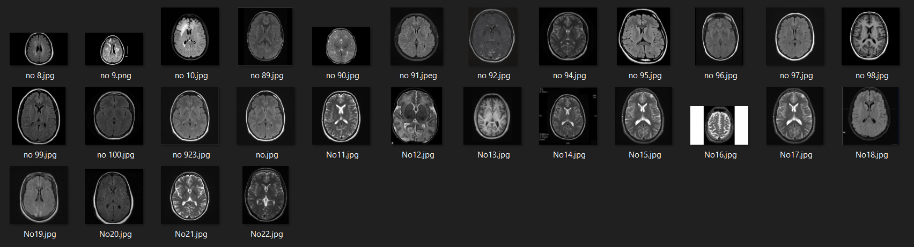
DATASET
TEST
YES
NO

Slide 5
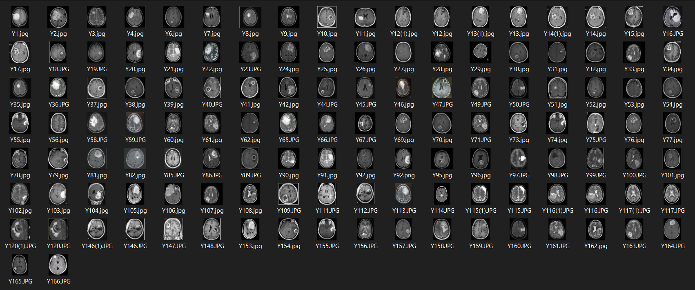
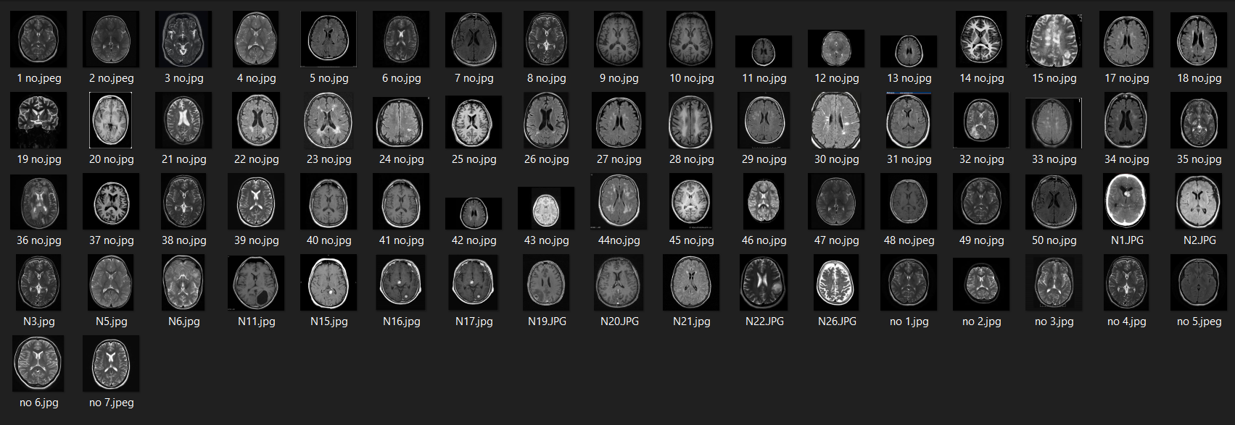
DATASET
TRAIN
YES
NO

Slide 6

Work Structural Chart
Download the DataSet
Function to encode the labels
Resize image to 64*64 Pixel and read a greyscale
Split data images for testing and training
Calculate Loss function It is Categorical Cross entropy
Build the Model
Reshape data appropriately for Tensorflow
Adam as Optimizer
Train the Deep Neural net for 5 epoches
Make Predictions

Slide 7
MODEL USED
Convolutional Neural Network
It is a Deep Learning algorithm which can take in an input image, assign importance (learnable weights and biases) to various aspects/objects in the image and be able to differentiate one from the other.

Slide 8
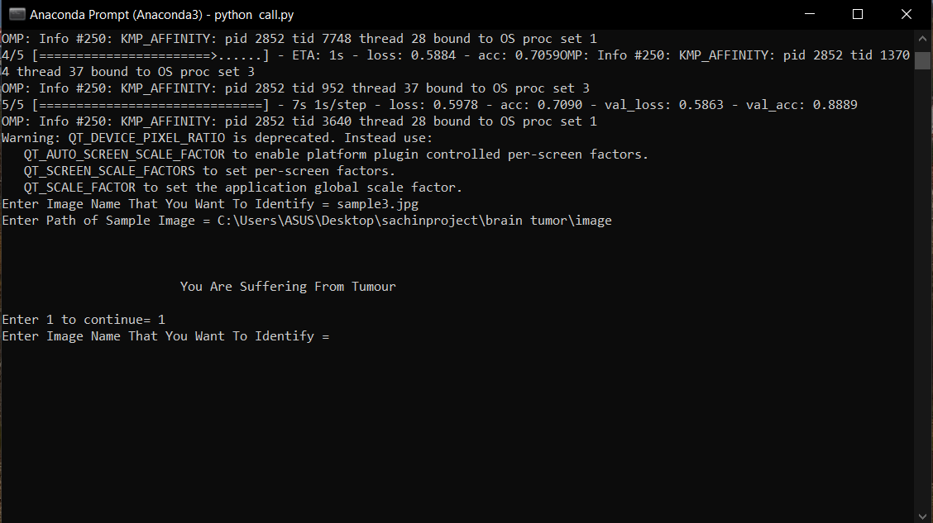
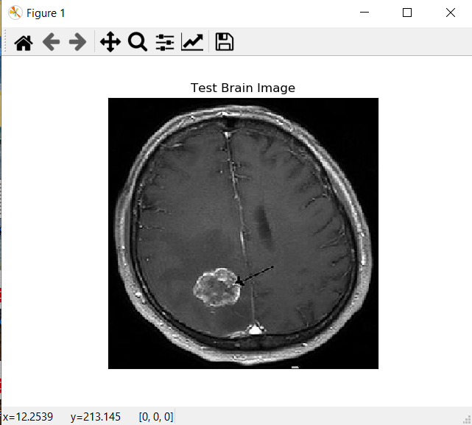
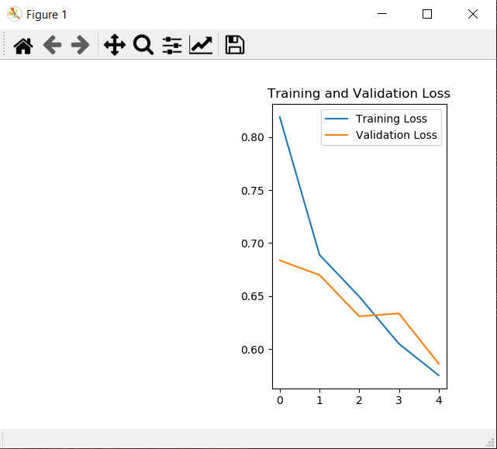
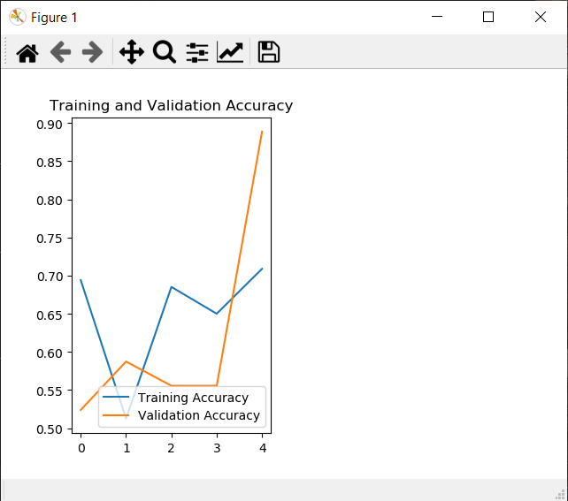
RESULTS

Slide 9
THANK YOU

